Slide 1
Object-Oriented Analysis and Design using JAVA
SOLID Principles

Slide 2
Introduction
In object-oriented programming languages, the classes are the building blocks of any application. If these blocks are not strong, the building (i.e. the application) is going to face a tough time in the future.
Poorly designed applications can lead the team to very difficult situations when the application scope goes up, or the implementation faces certain design issues either in production or maintenance.
On the other hand, a set of well designed and written classes can speed up the coding process, while reducing the tech debt and the number of bugs in comparison.
The SOLID principles are 5 most recommended design principles, that we should keep in mind while writing our classes.
Reference: https://howtodoinjava.com/best-practices/solid-principles/

Slide 3
Introduction to SOLID principles
Bob Martin and Micah Martin introduced these concepts in their book ‘Agile Principles, Patterns, and Practices’.
The acronym SOLID was meant to help us remember these principles easily. These principles also form a vocabulary we can use while discussing with other team members or as a part of technical documentation shared in the community.
SOLID principles form the fundamental guidelines for building object-oriented applications that are robust, extensible, and maintainable.
Reference: https://howtodoinjava.com/best-practices/solid-principles/

Slide 4
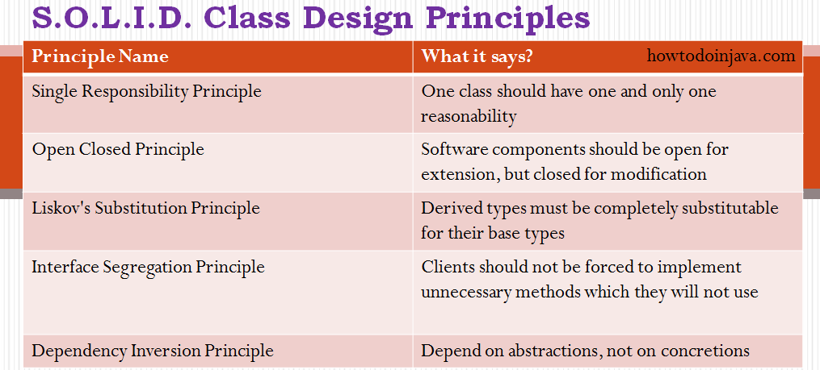
Reference: https://howtodoinjava.com/best-practices/solid-principles/

Slide 5
Single Responsibility Principle (SRP)
We may come across one of the principles of object-oriented design, Separation of Concerns (SoC), that conveys a similar idea. The name of the SRP says it all:
“One class should have one and only one responsibility”
In other words, we should write, change, and maintain a class only for one purpose. A class is like a container. We can add any amount of data, fields, and methods into it.
However, if we try to achieve too much through a single class, soon that class will become bulky. If we follow SRP, the classes will become compact and neat where each class is responsible for a single problem, task, or concern.
For example, if a given class is a model class then it should strictly represent only one actor/entity in the application. This kind of design decision will give us the flexibility to make changes in the class, in future without worrying the impacts of changes in other classes.
Reference: https://howtodoinjava.com/best-practices/solid-principles/

Slide 6
Open Closed Principle (OCP)
OCP is the second principle which we should keep in mind while designing our application. It states:
“Software components should be open for extension, but closed for modification”
It means that the application classes should be designed in such a way that whenever fellow developers want to change the flow of control in specific conditions in application, all they need to extend the class and override some functions and that’s it.
If other developers are not able to write the desired behavior due to constraints put by the class, then we should reconsider refactoring the class.
Reference: https://howtodoinjava.com/best-practices/solid-principles/

Slide 7
Example
public class Cat extends Animal {
@Override
public void makeNoise() {
System.out.println("meow meow");
}
}
class DumbDog extends Animal {
@Override
public void makeNoise() {
throw new RuntimeException("I can't make noise");
}
}
public class Animal {
public void makeNoise() {
System.out.println("I am making noise");
}
}
Now let’s consider the Cat and Dog classes which extends Animal.
public class Dog extends Animal {
@Override
public void makeNoise() {
System.out.println("bow wow");
}
}

Slide 8
Liskov’s Substitution Principle (LSP)
LSP is a variation of previously discussed open closed principle. It says:
“Derived types must be completely substitutable for their base types”
LSP means that the classes, fellow developers created by extending our class, should be able to fit in application without failure. This is important when we resort to polymorphic behavior through inheritance.
This requires the objects of the subclasses to behave in the same way as the objects of the superclass. This is mostly seen in places where we do runtime type identification and then cast it to appropriate reference type.
Reference: https://howtodoinjava.com/best-practices/solid-principles/

Slide 9
Interface Segregation Principle (ISP)
This principle is the first principle that applies to Interfaces instead of classes in SOLID and it is similar to the single responsibility principle.
It states that “do not force any client to implement an interface which is irrelevant to them“. Here your main goal is to focus on avoiding fat interface and give preference to many small client-specific interfaces.
You should prefer many client interfaces rather than one general interface and each interface should have a specific responsibility.
Suppose if you enter a restaurant and you are pure vegetarian. The waiter in that restaurant gave you the menu card which includes vegetarian items, non-vegetarian items, drinks, and sweets.
In this case, as a customer, you should have a menu card which includes only vegetarian items, not everything which you don’t eat in your food.
Here the menu should be different for different types of customers. The common or general menu card for everyone can be divided into multiple cards instead of just one. Using this principle helps in reducing the side effects and frequency of required changes.
Reference: https: https://www.geeksforgeeks.org/solid-principle-in-programming-understand-with-real-life-examples/

Slide 10
Dependency Inversion Principle (DIP)
High-level modules/classes should not depend on low-level modules/classes.
Abstractions should not depend upon details. Details should depend upon abstractions. The above lines simply state that if a high module or class will be dependent more on low-level modules or class then your code would have tight coupling and if you will try to make a change in one class it can break another class which is risky at the production level.
So always try to make classes loosely coupled as much as you can and you can achieve this through abstraction. The main motive of this principle is decoupling the dependencies so if class A changes the class B doesn’t need to care or know about the changes.
You can consider the real-life example of a TV remote battery. Your remote needs a battery but it’s not dependent on the battery brand. You can use any XYZ brand that you want and it will work. So we can say that the TV remote is loosely coupled with the brand name. Dependency Inversion makes your code more reusable.
Reference: https: https://www.geeksforgeeks.org/solid-principle-in-programming-understand-with-real-life-examples/

Slide 11
Coupling and cohesion

Slide 12
Introduction
Cohesion and Coupling deal with the quality of an OO design.
Generally, good OO design should be loosely coupled and highly cohesive.
The aim of the design should be to make the application:
easier to develop
easier to maintain
easier to add new features
less Fragile.

Slide 13
Coupling
Coupling is the degree to which one class knows about another class. Let us consider two classes class A and class B. If class A knows class B through its interface only i.e it interacts with class B through its API then class A and class B are said to be loosely coupled.
If on the other hand class A apart from interacting class B by means of its interface also interacts through the non-interface stuff of class B then they are said to be tightly coupled. Suppose the developer changes the class B‘s non-interface part i.e non API stuff then in case of loose coupling class A does not breakdown but tight coupling causes the class A to break.
So its always a good OO design principle to use loose coupling between the classes i.e all interactions between the objects in OO system should use the APIs. An aspect of good class and API design is that classes should be well encapsulated.

Slide 14
Tight coupling
If a class A has some public data members and another class B is accessing these data members directly using the dot operator(which is possible because data members were declared public), the two classes are said to be tightly coupled.
Such tight coupling between two classes leads to the bad designing. You would ask - Why? Well, here's the explanation.
Let's say, the class A has a String data member, name, which is declared public and the class also has getter and setter methods that have implemented some checks to make sure - Valid access of the data member, name i.e. it is only accessed when its value is not null, and Valid setting of the data member, name i.e. it cannot be set to a null value.
But these checks implemented in the methods of class A to ensure valid access and valid setting of its data member, name, are bypassed by its direct access by class B i.e. tight coupling between two classes.
Reference: https://www.decodejava.com/coupling-cohesion-java.htm

Slide 15
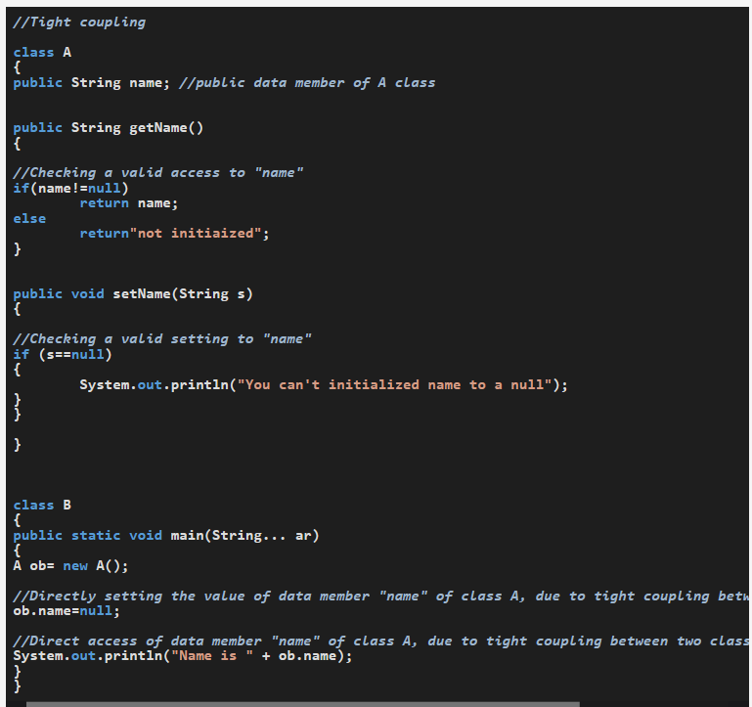
Program Analysis
Class A has an instance variable, name, which is declared public.
Class A has two public getter and setter methods which check for valid access and valid setting of data member - name.
Class B creates an object of A class and sets the value of its data member, name, to null and accesses it value directly by the dot operator because it was declared public.
Hence, the checks implemented in getName() and setName() methods of class Names, to access and set the data member's value of class A are never called and are rather, bypassed. It shows class A is tightly coupled to class B, which is a bad design, compromising the data security checks.
Reference: https://www.decodejava.com/coupling-cohesion-java.htm

Slide 16
Loose coupling
A good application designing is creating an application with loosely coupled classes by following proper encapsulation, i.e. by declaring data members of a class with the private access modifier, which disallows other classes to directly access these data members, forcing them to call public getter, setter methods to access these private data members. Let's understand this by an example -

Slide 17
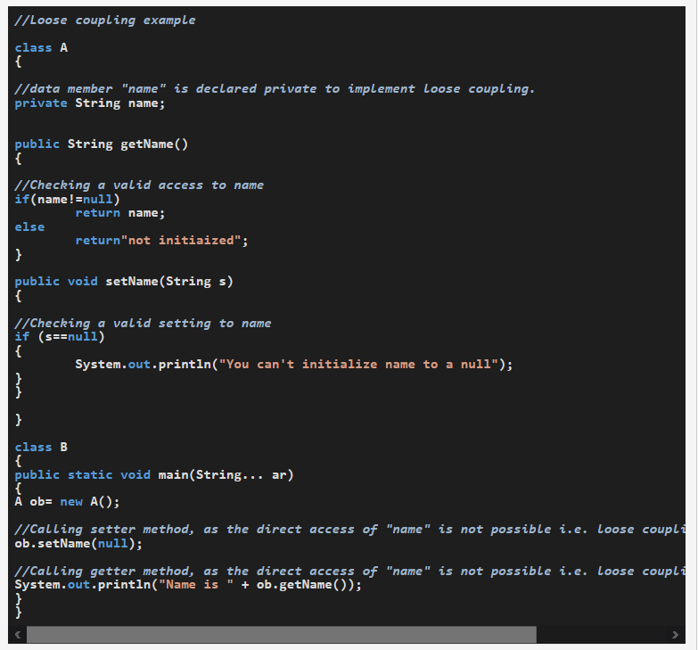
Program Analysis
Class A has an instance variable, name, which is declared private.
Class A has two public getter and setter methods which check for valid access and valid setting of the data member, name.
Class B creates an object of class A, calls the getName() and setName() methods and their implemented checks are properly executed before the value of instance member, name, is accessed or set. It shows class A is loosely coupled to class B, which is a good programming design.

Slide 18
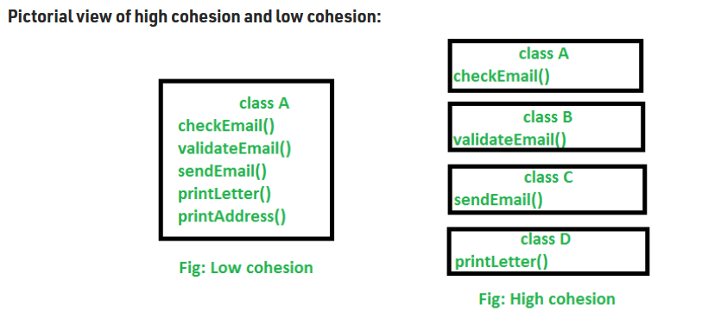
High and Low Cohesion
Explanation : In the above image, we can see that in low cohesion only one class is responsible to execute lots of job which are not in common which reduces the chance of re-usability and maintenance. But in high cohesion there is a separate class for all the jobs to execute a specific job, which result better usability and maintenance.
https://www.geeksforgeeks.org/cohesion-in-java/

Slide 19
High and Low Cohesion
Difference between high cohesion and low cohesion:
High cohesion is when you have a class that does a well defined job. Low cohesion is when a class does a lot of jobs that don’t have much in common.
High cohesion gives us better maintaining facility and Low cohesion results in monolithic classes that are difficult to maintain, understand and reduces re-usability
https://www.geeksforgeeks.org/cohesion-in-java/

Slide 20
Key references
https://howtodoinjava.com/best-practices/solid-principles/
https: https://www.geeksforgeeks.org/solid-principle-in-programming-understand-with-real-life-examples/

Slide 21
Thank You

